Slide 1


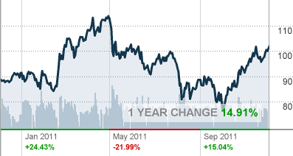
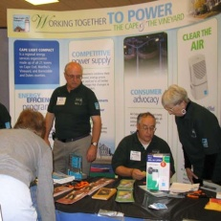



Cape light compact response to
Special Barnstable County Commission Recommendations - Relative to the Cape Light Compact
June 13, 2012

Slide 2
Topics
CLC June 13, 2012 Response to County Commissioners
CLC Key Milestones
Relationship between CLC, CVEC & Barnstable County
Transparency, Open Meeting Law and Public Records
Budgets and Oversight
Purpose of Regional Government
Recommendations
Appendix

Slide 3
Key Milestones
1995 Barnstable County Energy Management Plan – County Commissioners establish Barnstable County Energy Management Committee – focus on importance of locally administering energy efficiency funds.
1997 MA Electric Industry Restructuring Act - with Town Meeting/Town Council approval formed CLC through inter-governmental agreement. CLC authorized to aggregate electric customers in an opt-out power supply contract and administer energy efficiency programs in conjunction with power supply.
July, 2001 CLC’s first Energy Efficiency Plan approved by DTE – Implementation Begins.
March, 2005 Customer Choice Opt-out Competitive Power Supply Offering – CLC began serving all electric customer classes. RFP was issued in 2004 to select vendor to provide retail electric supply to all customers classes.
2000 Cape Light Compact Municipal Aggregation Plan Filed with DTE. CLC consulted with DOER on the preparation of and public hearings held to develop the Aggregation Plan. CLC enters into an administrative services agreement with Barnstable County to provide administrative and fiscal functions for CLC.

Slide 4
Key Milestones, continued
July, 2008 MA Green Communities Act approves expanded energy efficiency mandate/funding and “net metering” provisions to increase renewable generation statewide
January, 2010 MA DPU Issues CLC Order (D.P.U. 09-119) approving first 3-year statewide energy efficiency plan (2010-2012)
September, 2007 CVEC organized as legally distinct entity under Electric Cooperative Statute with three initial members: CLC, Barnstable County and Town of Barnstable. CVEC enters into administrative services agreement with Barnstable County (similar to CLC) to perform certain administrative and fiscal functions for CVEC.
2006 La Capra Associates Study reviewed options and provided recommendations for CLC to form CVEC to make investments in wholesale energy contracts and renewable energy generation to stabilize CLC rates over the long-term.

Slide 5
CLC & CVEC
Barnstable County Relationship
CLC
Municipal aggregator formed through inter-governmental agreement to: purchase power on behalf of all customers, administer energy efficiency programs and consumer advocacy.
Members include Barnstable County, Dukes County and all twenty-one municipalities located within the two Counties on Cape Cod and Martha’s Vineyard.
CVEC
Electric Cooperative legally distinct by statute to make investments in wholesale energy contracts and renewable energy generation to stabilize CLC rates over the long-term.
Members include Barnstable County; Dukes County; CLC; Towns of Barnstable, Harwich, Brewster, Dennis, Bourne, Eastham, Tisbury, Oak Bluffs, Mashpee, Orleans, Provincetown, Sandwich, Yarmouth, Falmouth, Chatham & West Tisbury.
Barnstable County Administrative Services Agreements with CLC and CVEC

Slide 6
Transparency,
Open Meeting Law &
Public Records
CLC complies with the Open Meeting Law and Public Records Law
Energy related activities are specifically enumerated in the executive session portion of the Open Meeting Law
The Public Records law also provides an exemption on energy related activities

Slide 7
Budgets & Oversight
Numerous Massachusetts state agencies have oversight of and involvement in CLC activities
CLC Operating Budget reviewed and approved by CLC Board
CLC energy efficiency plans and annual reports are reviewed by the MA Energy Efficiency Advisory Council (EEAC) and the MA Department of Public Utilities
  These filings contain detailed budget information
  These materials are publicly available
  The MA AG is a voting member of the EEAC who reviews and comments on CLC’s energy efficiency plans and reports

Slide 8
Next Steps
  CLC and County discussion on SmartGrid development
  Long Range Energy Planning
  Review existing Administrative Services Agreement

Slide 9
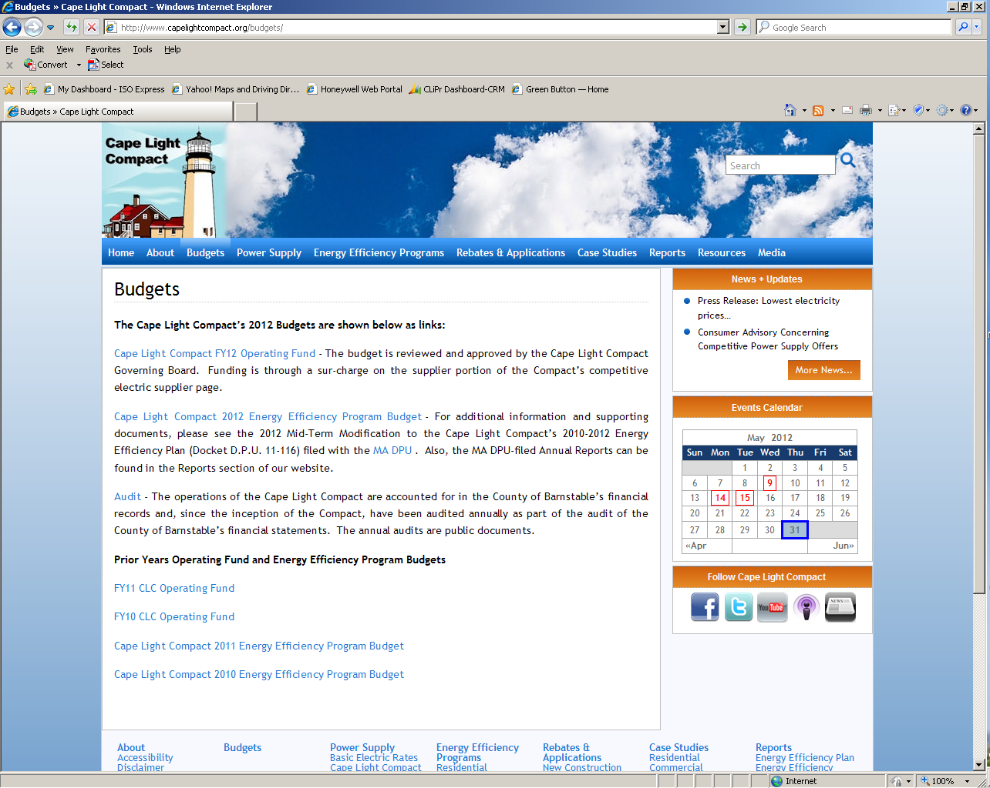
Appendix
Budget Tab of CLC website

Slide 10
Appendix
Budget Attachments
FY12 Operating Fund
FY11 Operating Fund
FY10 Operating Fund
2012 Energy Efficiency Program Budget
2011 Energy Efficiency Program Budget
2010 Energy Efficiency Program Budget
Audit Letter dated January 30, 2012

