Slide 1
Welcome
2013 Vendor Open House
Sponsored by Mass Save®
and
Cape Light Compact

Slide 2








Mass Save® Utility and Energy Efficiency Program Sponsors

Slide 3
Agenda
2013 Program Highlights
Custom
Natural Gas
Electric, Non-Lighting
CHP
Upstream
Lighting
MTAC
Financing
Networking

Slide 4
2013 Program Highlights
Meredith Miller

Slide 5
Custom Projects
Nicole Price

Slide 6
Custom Projects
Retrofit – Potential for up to 50% of the project cost
New Construction – Potential for up to 75% of the incremental cost
Projects are evaluated with a screening model for cost effectiveness
Technical Assistance funds may be available

Slide 7
Natural Gas
Matt Zenni

Slide 8
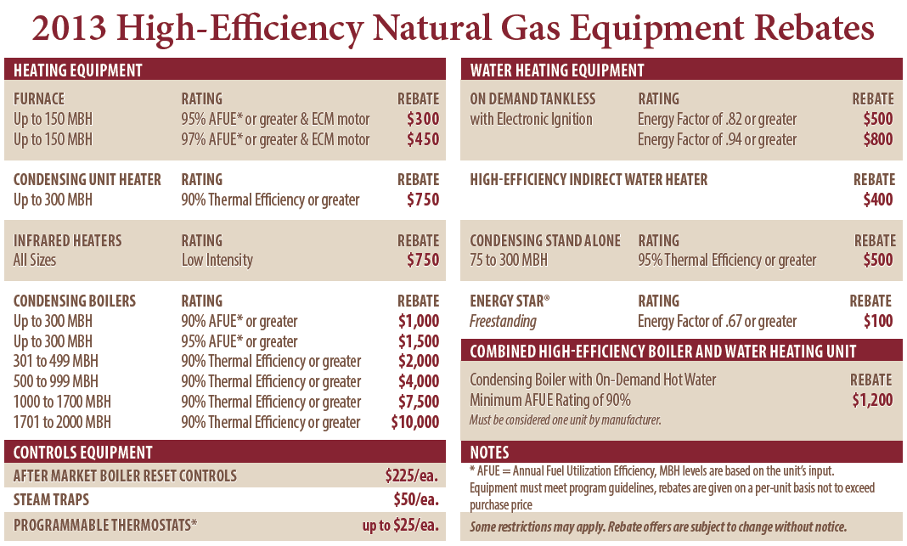
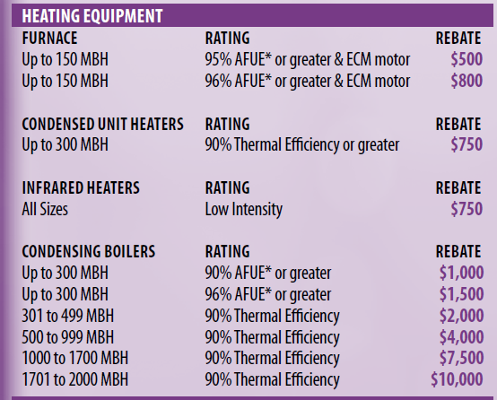
Heating Equipment
2012

Slide 9
Heating Equipment
Furnace Rebates 2013
  Furnace up to 150 MBH 95% AFUE or greater & ECM $300
  Furnace up to 150 MBH 97% AFUE or greater & ECM $450
Unit Heater Rebates 2013
  Unit Heater up to 300 MBH 90% Thermal Efficiency or greater $750
Infrared Heater Rebates 2013
  Infrared Heaters all sizes, Low Intensity $750

Slide 10
Hot Water Boiler
Condensing Boiler up to 300 MBH 90% AFUE or greater $1,000
Condensing Boiler up to 300 MBH 95% AFUE or greater $1,500
Condensing Boiler 301 to 499 MBH 90% Thermal Efficiency or greater $2,000
Condensing Boiler 500 to 999 MBH 90% Thermal Efficiency or greater $4,000
Condensing Boiler 1000 to 1700 MBH 90% Thermal Efficiency or greater $7,500
Condensing Boiler 1701 to 2000 MBH 90% Thermal Efficiency or greater $10,000
For Boiler greater then 2000 MBH, or for Boiler that have special use, please contact the Gas PA for custom incentive information

Slide 11
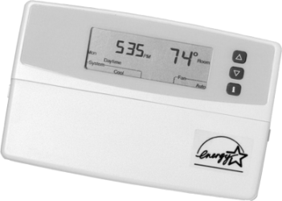
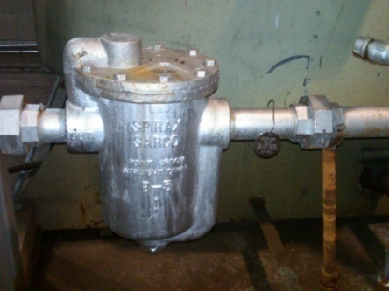
Controls
After Market Boiler Reset Control $225
Steam Traps $50
7 day Programmable Thermostats $25

Slide 12
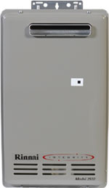
Water Heating Equipment
On Demand Tankless
  with electronic ignition Energy Factor of .82 or greater $500
  with electronic ignition Energy Factor of .94 or greater $800
High Efficiency Indirect Water Heater $400
Condensing Stand 75 to 300 MBH 95% Thermal Efficiency or greater $500
Integrated Water Heater/Condensing Boiler 90% AFUE $1200
  Must be a boiler
  Must be considered one unit by the manufacturer

Slide 13
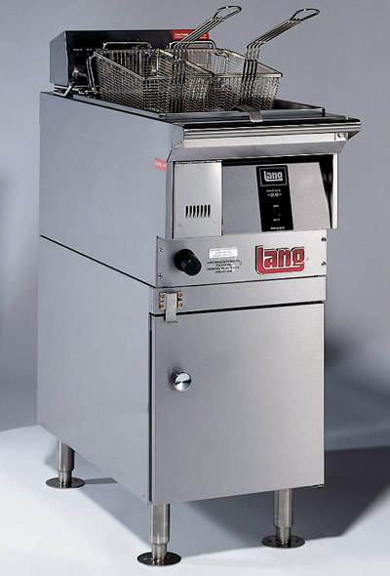
Kitchen Equipment
High-Efficiency Combination Oven $1000
High-Efficiency Rack Oven $1000
High-Efficiency Conveyor Oven $1000
ENERGY STAR® Fryer $1000
ENERGY STAR® Commercial Convection Oven $1000
ENERGY STAR® Commercial Steamer $1000
ENERGY STAR® Commercial Griddle $500
High-Efficiency Pre-Rinse Spray Valve $50/ea

Slide 14
Questions?

Slide 15
Electric, Non-Lighting
Nicole Price and Vicki Marchant

Slide 16
NEW ENERGY STAR®
Electric Kitchen Equipment
Commercial Fryers $150
Commercial Steam Cookers $1000
Convection Oven $500
Combination Steam/Convection Oven $2000
Hot food Holding Cabinets
  Full Size $900
  3/4 Size $750
  1/2 Size $600
Ice Machines
  Ice Making Head $250
  Remote Conditioned/Split Unit $200
  Self Contained $100
Commercial Griddle $400
Pre-Rinse Spray Valves $25
Commercial Dishwasher
  Under Counter or Door Type $250
  Single Tank Conveyer $100

Slide 17
Motors and Variable Speed Drives
Retrofit
  Added a 1-3 hp category
    $1000 Drive, $1200 Motor and Drive
  5 hp increased to match 7.5 hp incentive
    $2850 Drive, $3450 Motor and Drive
New Construction
  Added a 1-3 hp category
    $600 per Drive
  5 hp increased to match 7.5 hp
    $1500 per Drive

Slide 18
Cool Choice
Existing Incentives remain unchanged from 2012
Added
  Air Cooled Variable Refrigerant Flow AC
  Air Cooled Variable Refrigerant Flow Heat Pumps
  Water Source Variable Refrigerant Flow Heat Pumps
Qualifying efficiency levels reflect the nationally recognized CEE standards

Slide 19
Pay for Performance (P4P)
Existing Incentives remain unchanged from 2012
  $0.075 per kWh
  $0.75 per therm
Some clarification on M&V and TA Funds
  Savings identified at the measure level in accordance with IPM&VP
    PAs need to know the measure that resulted in the savings
For projects where additional analysis is needed, TA funds may be provided
    Capital projects, not P4P ECMs

Slide 20
Compressed Air
Existing Incentives remain unchanged from 2012
Compressed Air
  15-75 hp
  Load/No Load $100 per hp
  VSD $200 per hp
Zero-Loss Condensate Drains
  $125 per drain
Low Pressure Drop Filters
  $0.80 per standard cfm
Storage Incentives
  $2.75 per gallon

Slide 21
Vending Misers
Existing Incentives remain unchanged from 2012
Refrigerated Beverage Vending Machine $ 115
Glass Front Refrigerated Coolers $ 115
Non-Refrigerated vending Machines $ 45

Slide 22
HVAC Chillers – Incentives and Size Categories Unchanged form 2012

Slide 23
Energy Management Systems
Existing Incentives remain unchanged from 2012
  $225/ point for all size buildings
Building Size (5,000–40,000 sqft): 16 electric & 4 gas
Building Size (40,001–80,000 sqft): 48 electric & 12 gas
Building Size (80,001–200,000 sqft):128 electric & 32 gas

Slide 24
Advanced Buildings
Comprehensive suite of prescriptive measures that should result in 15% to 25% savings versus code.
Incentive is up to $1.50 / SF combined gas and electric
Free technical support
STRETCH CODE!! Up to 104 communities in MA that must, by law, comply with Advanced Buildings or CDA for all new construction. These buildings are still eligible for incentives.

Slide 25
Combined Heat & Power
Dinesh Patel

Slide 26
Project Considerations
Passes Massachusetts’ Benefit/Cost Model
  Installed Cost
  kWh and heat utilization
  Incremental fuel usage
  Run hours with on site use of thermal energy
Maintenance Costs
Combined Electric and Thermal Efficiency (HHV basis)
  Projects with less than 60% combined efficiency unlikely to be cost effective or will not have a good payback for the customer.
Building energy efficiency measures that have higher B/C ratios should be implemented first or at the same time
  Lower hanging fruit first
  CHP design could be affected by EE measures - design CHP based on the assumption that other measures will be implemented.
Incentives
  150 kW or less, incentive is $750 per kW
  Over 150 kW, see your account executive
  Maximum incentive up to 50% of Installed Cost

Slide 27
Third Party Review and TA Studies
Customers may request a TA Study
PA pays a portion of the study performed by an agreed upon independent TA vendor.
Not All feasibility studies performed by CHP Vendors are subsidized by the PAs – will be reviewed by the PAs or their TA Vendor at their own cost.

Slide 28
Factors to Consider
Interconnection requirements and schedule
Gas availability
Right sizing the CHP unit
Ability to operate and maintain
Ability to manage the project implementation

Slide 29
New Policy Changes
Incentives for replacing existing (older than measure life) operating CHP which was not previously incentivized by any PA programs
  Consider New Construction. Base case will be as if the CHP was not installed.
Replacement of the existing incentivized units
  Incremental cost = ( cost of new unit - salvage value )
  Incremental KW, kWh, fuel, etc.
  Pass BCR test
  Incentive = ( Based on new unit size – incentive paid for old unit )
M&V Metering
  Customer to install as required by the MRD. PA may subsidize

Slide 30
Summary
CHP can be a good energy savings opportunity for certain customers
Careful analysis is necessary to ensure the facility’s thermal and electric needs and profile are consistent with CHP equipment selection
System needs to be properly controlled to minimize thermal dumping and exporting of power
Obtain early involvement of Program Administrator!

Slide 31
Questions?

Slide 32
Mass Save Bright Opportunities
(Upstream Lighting)
Vicki Marchant

Slide 33
Upstream Model
Notes:
Buy down price of high efficiency equipment at the wholesale level

Slide 34
Upstream Model & Market Transformation
Customers
Energy efficient products at a comparable cost to conventional products
Reduce O&M costs during product lifetime
Eliminates need for PA Application

Slide 35
Upstream Model & Market Transformation
Program Administrators
Leverage manufacturer and distributors sales and marketing resources
Maximum savings at a lower cost
Distributors
Increase sales
Up-sell premium products

Slide 36
Upstream RWT8s & T5HO
First-generation T8 lamps (including 700 series or basic grade) have the lowest color rendering and the shortest lifespan among all T8s.
Reduced-wattage lamps have better color rendering properties and longer lumen maintenance –products and people will appear in a more natural color.
RW T8 and T5HO lamps use up to 22% less energy and last 33-67% longer than traditional lamps.
Typical applications
    Retail
    Offices
    Schools
    Hospitals
    Parking garages

Slide 37
Increased Incentives for RW T8 & T5HO Lamps
Current Incentives
Notes:
All Products must be listed in the eligible products lists to be eligible for incentives.
These incentives are in addition to “downstream” incentives available through PA application

Slide 38
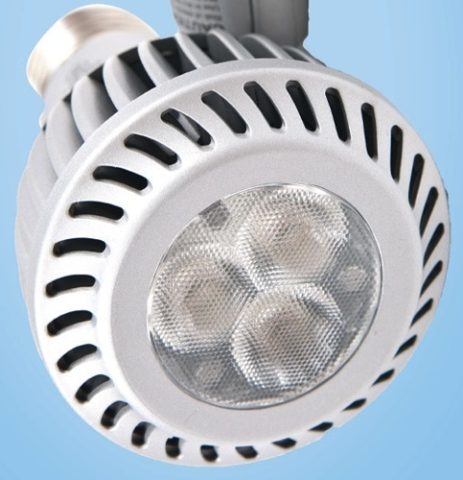
Upgrade to LEDs and Start Saving
Provide up to 80% energy and cost savings, last at least 10 times longer than traditional lamps, and generate less heat for greater customer comfort and lower A/C costs.
All eligible LED replacement lamps are ENERGY STAR® qualified, provide excellent CRI (Color Rendering Index) and have instant-on capability – many are also dimmable.
LEDs do not contain mercury
Typical applications
  Retail
  Restaurants
  Hotels
  Museums and Galleries

Slide 39
New LED lamps included in the Program
Current Incentives
Notes:
All Products must be listed in the ENERGY STAR ® list to be eligible for incentives

Slide 40
Program Requirements
Purchaser contact information (customer or contractor)
End-user installation address (if different from the purchaser address)
Building/site name or number
Minimum customer contribution of $5 per LED and $1 per T8 or T5 lamp
All sales subject to site verifications

Slide 41
2013 Goal: Continue to Build the Program
New Upstream Portfolio Manager position
  Represent all Mass Save PAs
Enhance local program support from Ecova
  Jackson Hale, Massachusetts based new Program Manager
Select Mass Save Preferred Distributors
  Top performing T8/T5 distributors
New product additions
Increase QA/QC enforcement
  Review distributor sales data, conduct site inspections

Slide 42
Mass Save® Bright Opportunities (Upstream Lighting) www.masssave.com/upstream_lighting

Slide 43
Lighting Systems & Controls
Vicki Marchant and Nicole Price

Slide 44
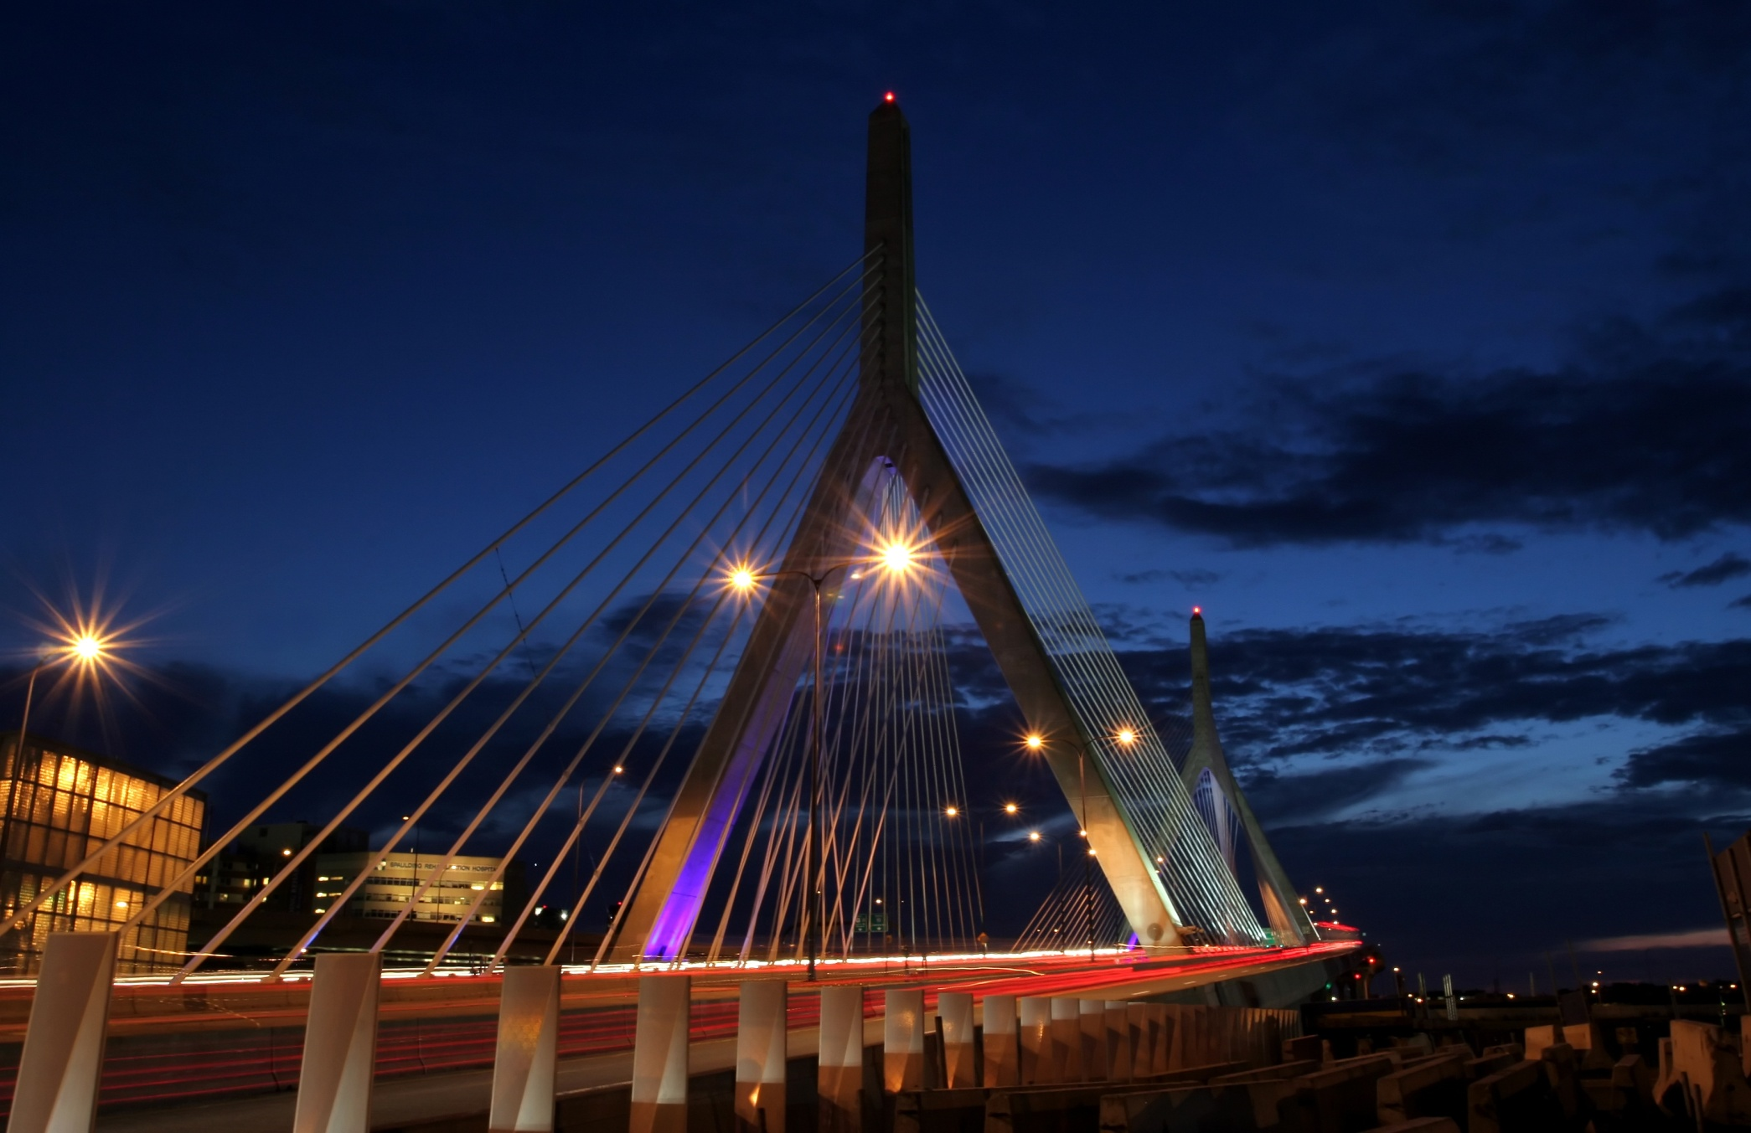
Agenda
New Construction
Retrofit
Performance Lighting

Slide 45
Why Lighting?
Energy Usage in
Non-Residential Buildings
40% Applications
Lighting
Source: DOE EIA
Lighting is the biggest end-use in non-residential buildings
Notes:
45
The Department of Energy has studied the Energy Use of Commercial Buildings and has discovered roughly 30% of the entire buildings load comes from lighting equipment. If we look at particular buildings such as schools, we find that roughly 40-45% of the building load is lighting equipment.
So the Answer to the question “ WHY LED LIGHTING” because we can save roughly 60% energy over standard technology. Meaning we can calculate that in the future LED lighting equipment would only be consuming 12-15% of the building load. These 60% energy savings numbers are real, we are looking to reach them sooner than later (2012)
The technology would save building owners money on their electric bill and disposal ( no mercury content)

Slide 46
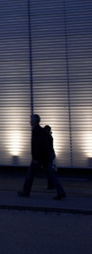
Lighting & Lighting Controls
CHANGES
Retrofit & New Construction
Added new LED categories
Adjusted incentives
Consolidated control categories
Streamlined application forms / tables

Slide 47
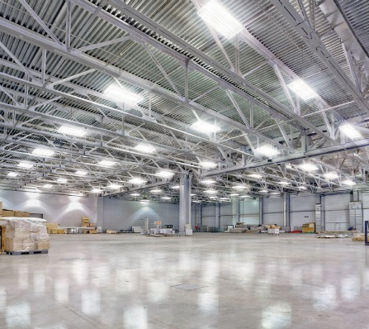
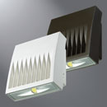
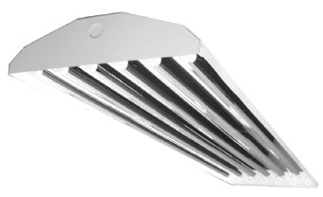
New Construction
Code 56/57
Min and Max
207W - 195W
104W - 96W

Slide 48
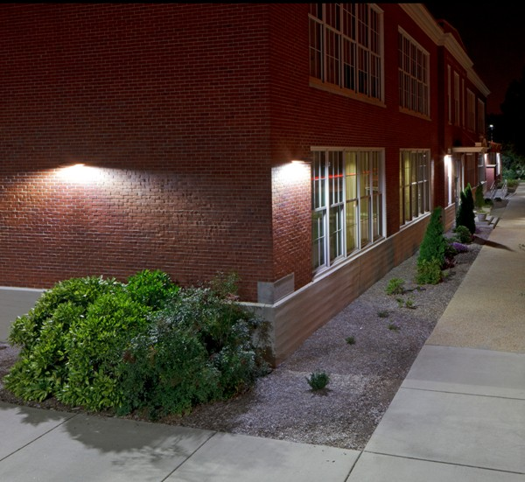
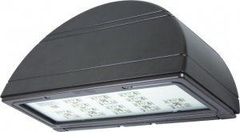
New Construction (cont.)
Code 85
$50

Slide 49
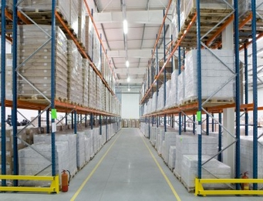
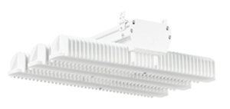
New Construction (cont.)
Code 86
$100

Slide 50
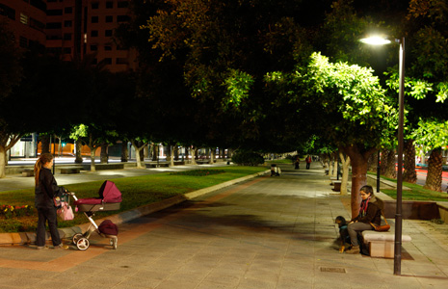
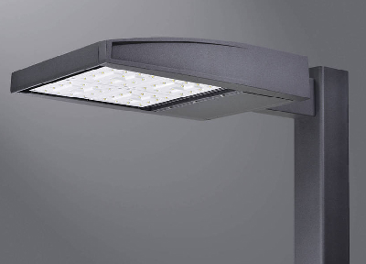
New Construction (cont.)
Code 87
$150

Slide 51
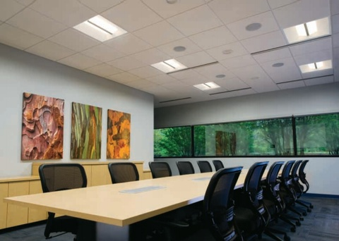
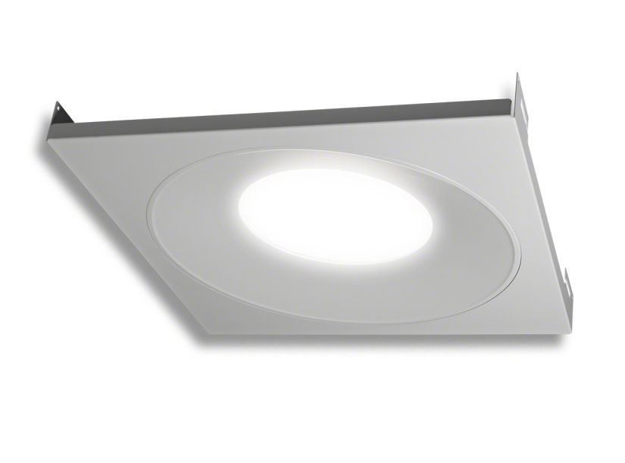
New Construction (cont.)
Code 88
$50

Slide 52
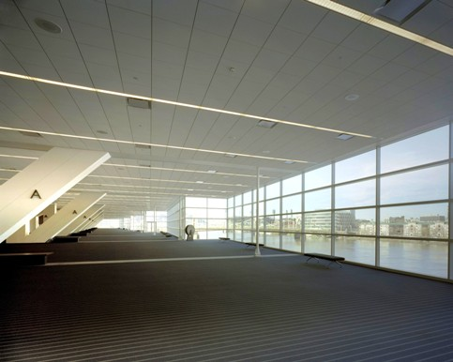
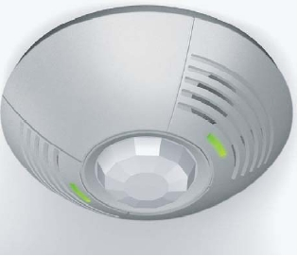
New Construction (cont.)
Code 62
Consolidated 62 + 63
$25 - $15
53W – 40W

Slide 53
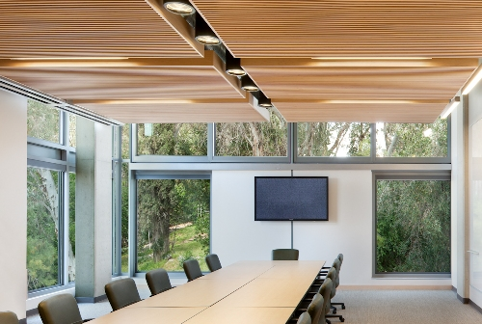
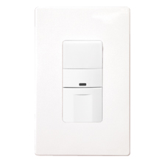
New Construction (cont.)
Code 64
Consolidated 62 + 63
$25 - $15
53W – 40W

Slide 54
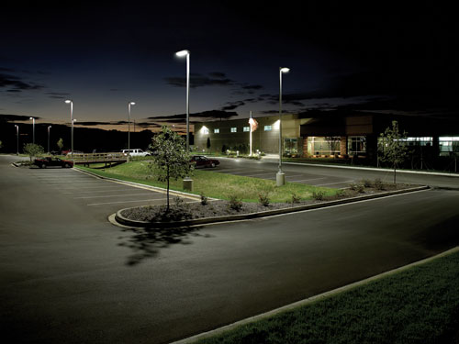
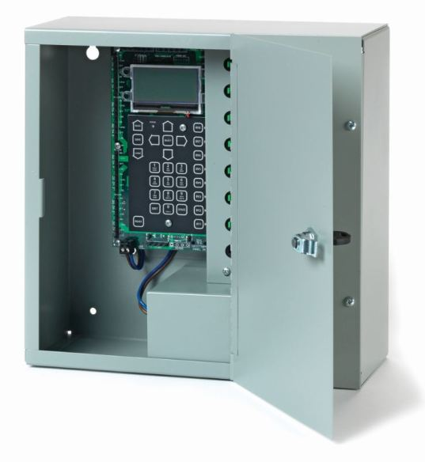
New Construction (cont.)
Code 65
Another option
$50

Slide 55
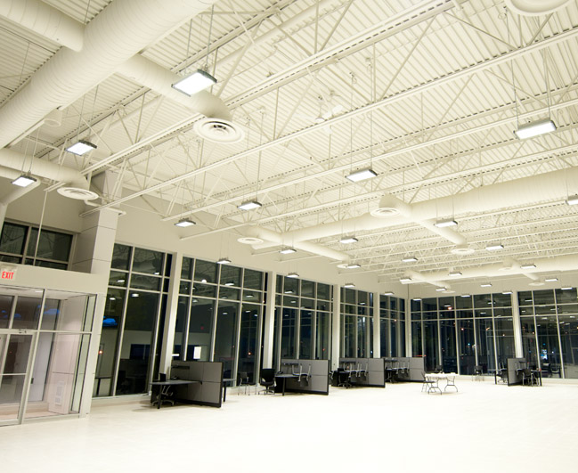
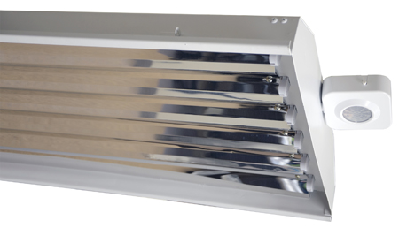
New Construction (cont.)
Code 65
Fluorescent & LED
100W - 95W

Slide 56
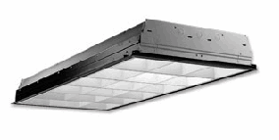
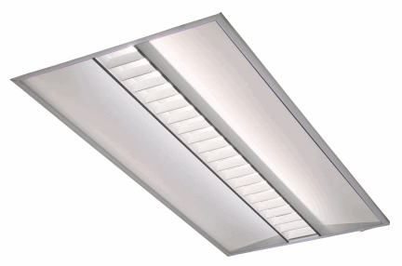
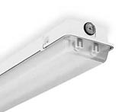
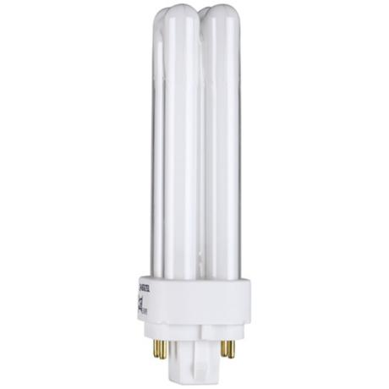
Retrofit
Code 32 | $42 - $35 2x2 80%-75%
Code 34 | $50 - $45
Code 43 | $75 - $65
Code 22 | $20 - $15
Code 23 | Discontinued

Slide 57
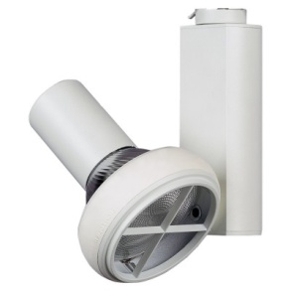
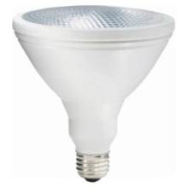
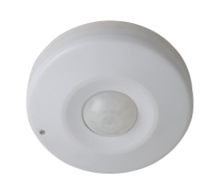
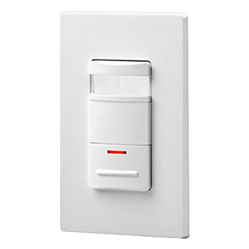
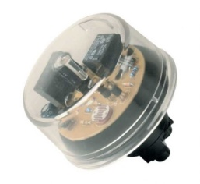
Retrofit (cont.)
Code 70 | $50 - $25
Code 71 | Discontinued
Code 61 | $85 - $60
Code 62 | $30 - $25
Code 65 | $70 - $50
Code 68 | $40 - $25

Slide 58
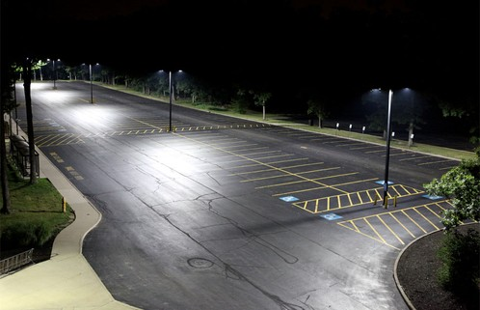
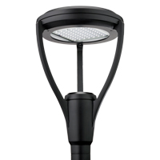
Retrofit (cont.)
Code 87
From $100 to $200

Slide 59
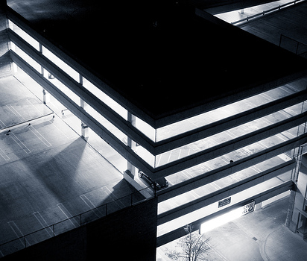
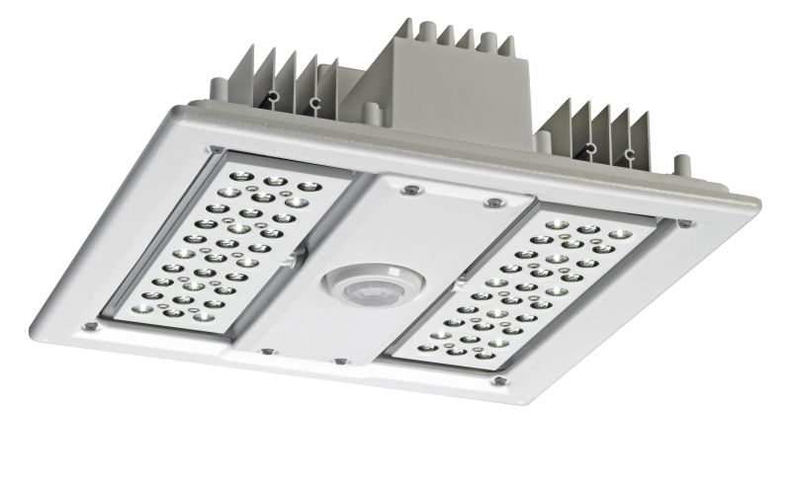
Retrofit (cont.)
Code 83A & 83B
$200 Complete and 24/7
$100 Retrofit Kit
and Dusk to Dawn

Slide 60
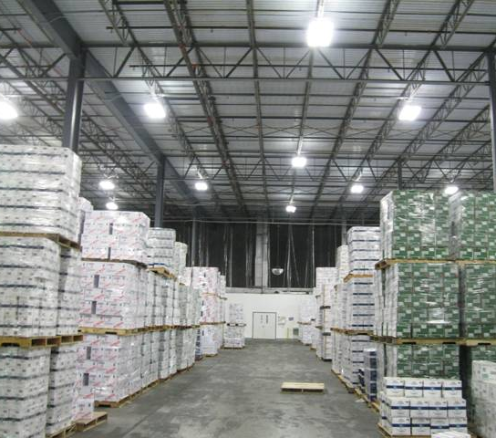
Retrofit (cont.)
Code 86A & 86B
$150 Complete and 4,380 hrs
$100 Retrofit Kit

Slide 61
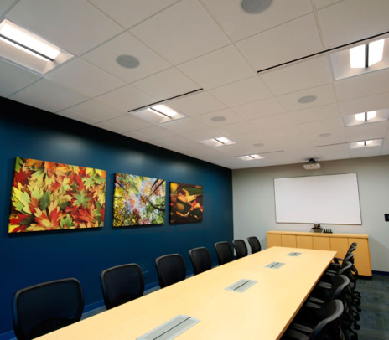
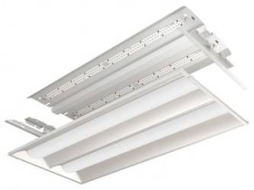
Retrofit (cont.)
Code 88A & 88B
$60 Complete Fixture
$40 Retrofit Kit

Slide 62

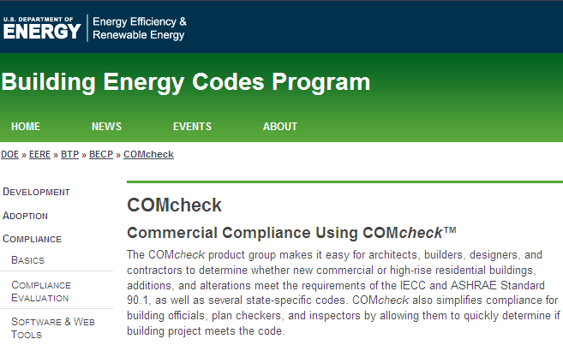
Performance Lighting
Watts Allowed Per sq. ft
Performance Initiative – Dependent on COMcheck
New Construction or Major Renovation

Slide 63
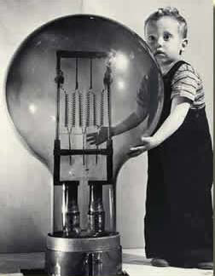
Performance Lighting (cont.)
Tier 1: 15% Better than Code
No fixture restriction
$ 0.40 per watt

Slide 64
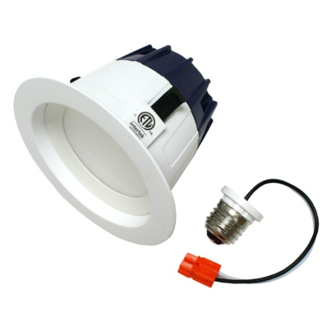


Performance Lighting (cont.)
Tier 2: 25% Better than Code
Fixture restriction
Majority of Products: HP / RW T8/T5/T5HO Fixture efficiency > 75%
Linear LED DLC 1X4/2X4/2X2
Majority of the balance: DLC / Energy Star an/or
Innovative technologies
$ 1.20 per watt

Slide 65
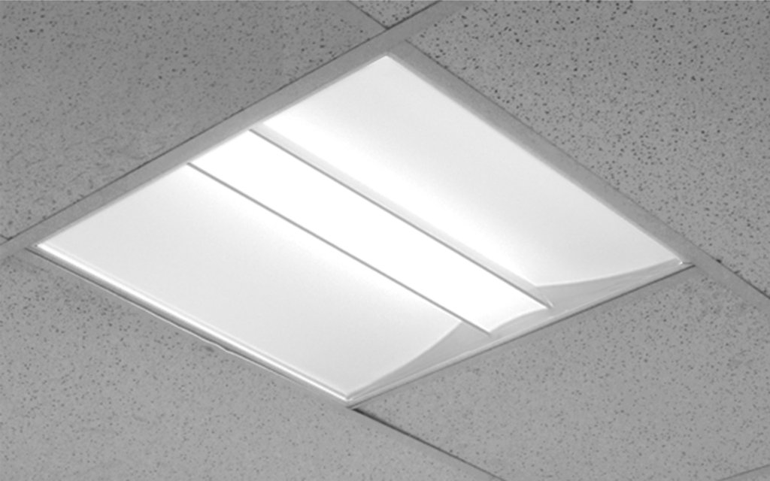
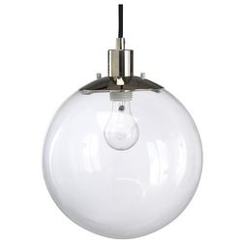
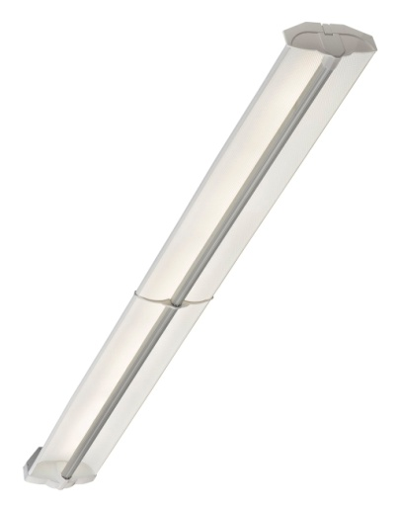

Performance Lighting (cont.)
Tier 2: 25% Example
COMcheck fixture count: 100 units
HP/RW T8-T5-T5HO > 75% 52
Linear LED 2x2/2x4/1x4
DLC - Energy Star and/or 26
Innovative technologies
Others 22
Total 100
76%
$ 1.20 per watt

Slide 66


Performance Lighting (cont.)
Tier 2: 25% Example
COMcheck fixture count: 100 units
HP/RW T8-T5-T5HO > 75% 75
Linear LED 2x2/2x4/1x4
DLC - Energy Star and/or 0
Innovative technologies
Others 25
Total 100
76%
$ 1.20 per watt

Slide 67
Massachusetts Technical Assessment Committee (MTAC)
Nicole Price

Slide 68
Overview
Goal is to evaluate promising new natural gas and electric efficiency technologies using a consistent statewide process
Provide a single point of contact to submit new technologies for review
Provide a single definitive source for determining Mass Save® eligibility
Apply a single statewide method for calculating energy savings
The MTAC committee has one member from each PA

Slide 69
Overview (cont.)
Each new technology must pass Mass Save® Benefit Cost Ratio Screening
  Starts as a custom measure with individual evaluation of cost & savings for each project
  Appropriate technologies may evolve into a prescriptive offering
Application policy for new technologies available on the Mass Save® website
Separate commercial/industrial & residential MTAC committees merging in 2013

Slide 70
Mass Save Financing
Vicki Marchant

Slide 71
Overview
No changes in 2013
  Scheduled interest payments on the loan will be pre-paid by the PA in lieu of a portion of the Mass Save incentive or rebate
  Loans available up to $100,000 with terms up to 7 years, contingent on the amount of the qualifying incentive
  Financing subject to approval by the participating lender
  Improvements require PA pre-approval

Slide 72
How To Apply
Submit energy efficiency application to PA
Indicate interest in financing to PA
Obtain Pre-approval letter along with Interest Subsidy Authorization Form from PA
Customer submits Pre-approval Letter and Interest Subsidy Authorization form to the Lender for approval to secure loan
Measures are installed
Notify PA and Lender when installation is complete
PA will verify measures through an on-site inspection and notify the Lender once the project passes
Submit final costs to both the PA and Lender
Lender will release the loan
PA will release any incentive

Slide 73

THANK YOU

Slide 74
For More Information… www.masssave.com www.capelightcompact.org

